Slide 1

Analyzing Large-Scale Human Mobility Data: A Survey of Machine Learning Methods and Applications
Rozhina Ghiasi 401725137

Slide 2
Table of contents
1
2
3
4
Introduction
Understanding Human Mobility Data
Machine Learning Methods for Human Mobility Analysis
4
Application classes of human mobility patterns
5
Challenges and Future Directions
6
Conclusion
1

Slide 3

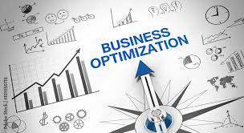
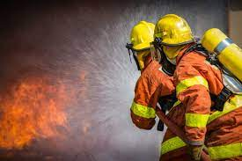


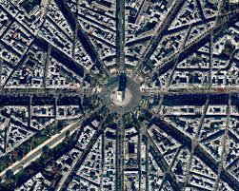
Introduction
The importance of large-scale human mobility data analysis:
1. Urban Planning
2. Transportation Management
3. Public Health
4. Business Optimization
5. Emergency Response
2

Slide 4

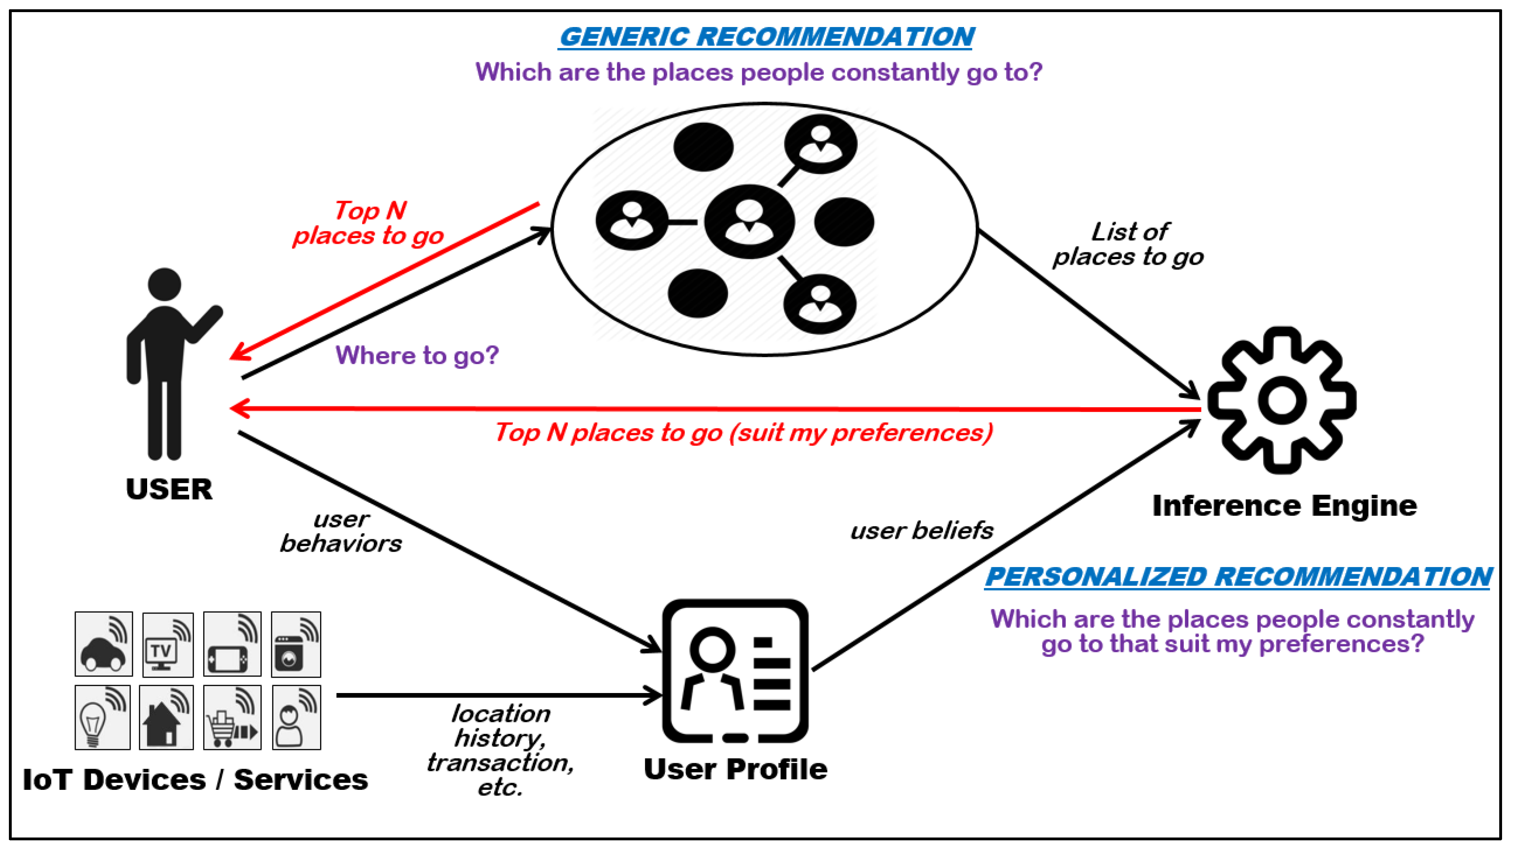
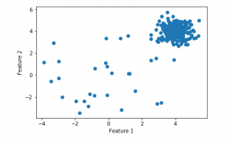
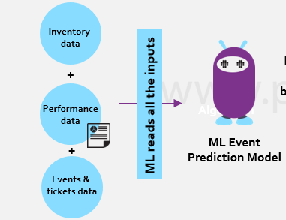

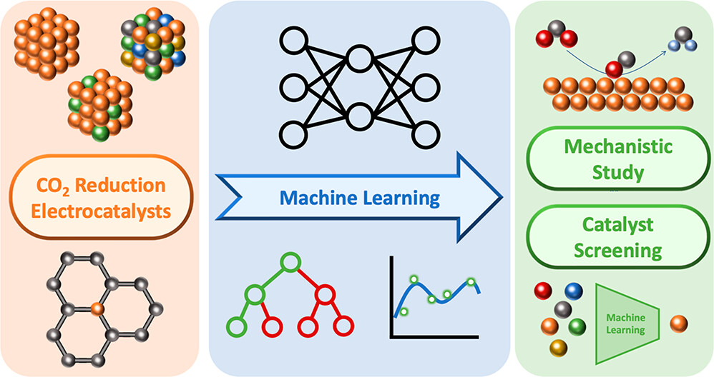
Introduction
why machine learning methods are useful in Human Mobility?
1. Handling Big Data
2. Pattern Discovery
3. Prediction
4. Anomaly Detection
5. Personalization and Context-Awareness
6. Scalability and Automation
3

Slide 5
Table of contents
1
2
3
4
Introduction
Understanding Human Mobility Data
Machine Learning Methods for Human Mobility Analysis
4
Application classes of human mobility patterns
5
Challenges and Future Directions
6
Conclusion
4

Slide 6








Understanding Human Mobility Data
What is human mobility?
2. The challenges associated with large-scale human motion data analysis:
Data Collection
Spatial and Temporal Complexity
Data Quality
integration of Multiple Data Sources
Scalability
Interpretation and Visualization
Privacy
5

Slide 7
Table of contents
1
2
3
4
Introduction
Understanding Human Mobility Data
Machine Learning Methods for Human Mobility Analysis
4
Application classes of human mobility patterns
5
Challenges and Future Directions
6
Conclusion
6

Slide 8
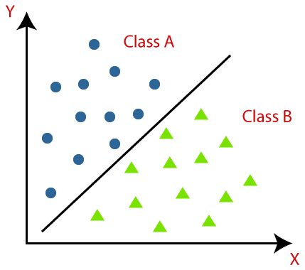

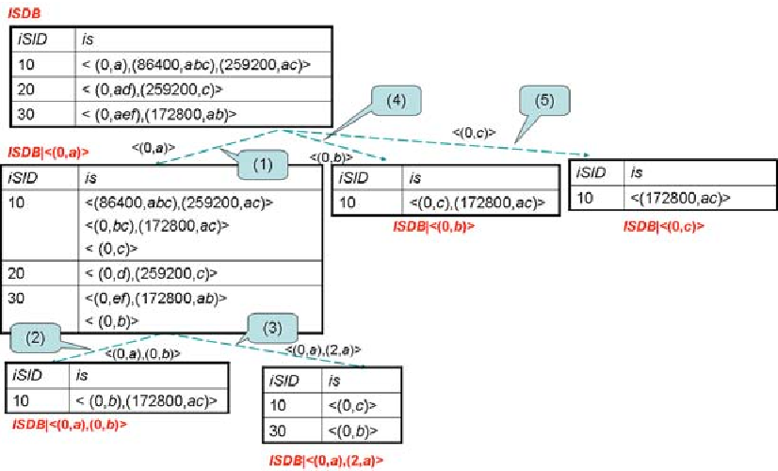
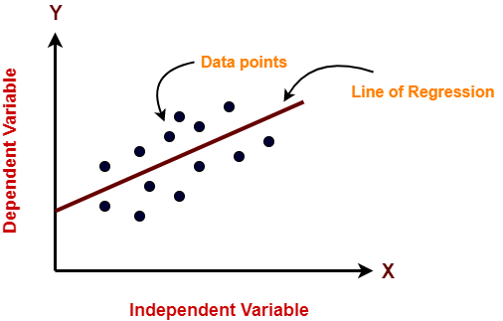
Machine Learning Methods for Human Mobility Analysis
1. Clustering Algorithms
2. Classification Algorithms
3. Sequence Mining Algorithms
4. Regression Algorithms
7

Slide 9
Table of contents
1
2
3
4
Introduction
Understanding Human Mobility Data
Machine Learning Methods for Human Mobility Analysis
4
Application classes of human mobility patterns
5
Challenges and Future Directions
6
Conclusion
8

Slide 10


Application classes of human mobility patterns
1
User modeling
Predicting future mobility of a user can be tremendously beneficial in numerous applications such as :
recommendation systems
forecasting the dynamics of crowds
traffic control
location-based advertising
Example :a ride-sharing app
9

Slide 11

Application classes of human mobility patterns
2
place modeling
can be used for various applications such as :
urban planning
targeted advertising
tourist suggestions
Example :a tourism app
10

Slide 12
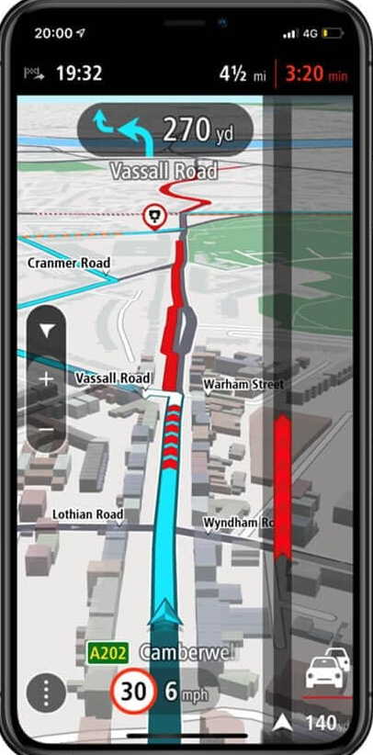
Application classes of human mobility patterns
3
Trajectory Modeling
can be used for various applications such as:
traffic prediction
anomaly detection
route planning
Example :a traffic management application
11

Slide 13
Table of contents
1
2
3
4
Introduction
Understanding Human Mobility Data
Machine Learning Methods for Human Mobility Analysis
4
Application classes of human mobility patterns
5
Challenges and Future Directions
6
Conclusion
12

Slide 14

Challenges and Future Directions
Standardized and succinct mobility models
End user applications
Data labeling
Privacy threats
13

Slide 15
Table of contents
1
2
3
4
Introduction
Understanding Human Mobility Data
Machine Learning Methods for Human Mobility Analysis
4
Application classes of human mobility patterns
5
Challenges and Future Directions
6
Conclusion
14

Slide 16
Conclusions
The paper highlights the significance of human mobility data analysis in various domains, including transportation planning, urban development, epidemiology, and social network analysis.
the paper emphasizes the importance of machine learning in harnessing the potential of large-scale human mobility data.
15

Slide 17
References
Toch, E., Lerner, B., Ben-Zion, E. et al. ”Analyzing large-scale human mobility data: a survey of machine learning methods and applications”. Knowl Inf Syst 58, 501–523 .2019.[CrossRef]
16

Slide 18
Thank you.

